Slide 1
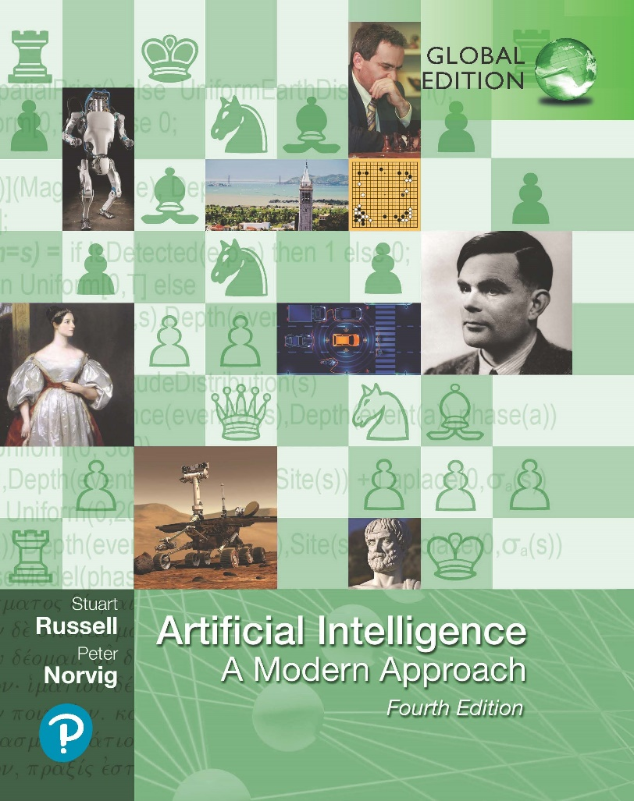
Artificial Intelligence: A Modern Approach
Fourth Edition, Global Edition
Chapter 7
Logical agents
© 2022 Pearson Education Ltd.

Slide 2
Outline
Knowledge-based agents
Wumpus world
Logic in general—models and entailment
Propositional (Boolean) logic
Equivalence, validity, satisfiability
Inference rules and theorem proving
resolution
forward chaining
backward chaining
Effective Propositional Model Checking
© 2022 Pearson Education Ltd.

Slide 3
Knowledge bases
Inference engine
domain−independent algorithms
Knowledge base
domain−specific content
Knowledge base = set of sentences in a formal language
Declarative approach to building an agent (or other system):
Tell it what it needs to know
Then it can Ask itself what to do—answers should follow from the KB Agents can be viewed at the knowledge level
i.e., what they know, regardless of how implemented
Or at the implementation level
i.e., data structures in KB and algorithms that manipulate them
© 2022 Pearson Education Ltd.

Slide 4
A simple knowledge-based agent
function KB-Agent( percept) returns an action
static: KB, a knowledge base
t, a counter, initially 0, indicating time
Tell(KB, Make-Percept-Sentence( percept, t)) action ← Ask(KB, Make-Action-Query(t)) Tell(KB, Make-Action-Sentence(action, t))
t ← t + 1
return action
The agent must be able to: Represent states, actions, etc. Incorporate new percepts
Update internal representations of the world Deduce hidden properties of the world Deduce appropriate actions
© 2022 Pearson Education Ltd.

Slide 5



Wumpus World PEAS description
Performance measure
gold +1000, death -1000
-1 per step, -10 for using the arrow Environment
Squares adjacent to wumpus are smelly Squares adjacent to pit are breezy Glitter iff gold is in the same square
Shooting kills wumpus if you are facing it Shooting uses up the only arrow Grabbing picks up gold if in same square Releasing drops the gold in same square
Actuators Left turn, Right turn, Forward, Grab, Release, Shoot
Stench |  | Breeze | PIT
 | Breeze Stench Gold | PIT | Breeze
Stench |  | Breeze
START | Breeze | PIT | Breeze
4
3
2
1
1
2
3
4
Sensors Breeze, Glitter, Smell
© 2022 Pearson Education Ltd.

Slide 6
Wumpus world characterization
Observable??
© 2022 Pearson Education Ltd.

Slide 7
Wumpus world characterization
Observable?? No—only local perception
Deterministic??
© 2022 Pearson Education Ltd.

Slide 8
Wumpus world characterization
Observable?? No—only local perception
Deterministic?? Yes—outcomes exactly specified Episodic??
© 2022 Pearson Education Ltd.

Slide 9
Wumpus world characterization
Observable?? No—only local perception
Deterministic?? Yes—outcomes exactly specified Episodic?? No—sequential at the level of actions Static??
© 2022 Pearson Education Ltd.

Slide 10
Wumpus world characterization
Observable?? No—only local perception
Deterministic?? Yes—outcomes exactly specified Episodic?? No—sequential at the level of actions Static?? Yes—Wumpus and Pits do not move Discrete??
© 2022 Pearson Education Ltd.

Slide 11
Wumpus world characterization
Observable?? No—only local perception
Deterministic?? Yes—outcomes exactly specified Episodic?? No—sequential at the level of actions Static?? Yes—Wumpus and Pits do not move Discrete?? Yes
Single-agent??
© 2022 Pearson Education Ltd.

Slide 12
Wumpus world characterization
Observable?? No—only local perception
Deterministic?? Yes—outcomes exactly specified Episodic?? No—sequential at the level of actions Static?? Yes—Wumpus and Pits do not move Discrete?? Yes
Single-agent?? Yes—Wumpus is essentially a natural feature
© 2022 Pearson Education Ltd.

Slide 13
Exploring a wumpus world
OK
OK A | OK
© 2022 Pearson Education Ltd.

Slide 14
Exploring a wumpus world
B
OK
A
OK
OK
A
© 2022 Pearson Education Ltd.

Slide 15
Exploring a wumpus world
P?
B
OK
P?
A
OK
OK
A
© 2022 Pearson Education Ltd.

Slide 16
Exploring a wumpus world
P?
B
OK
P?
A
OK
S
OK
A
A
© 2022 Pearson Education Ltd.

Slide 17
Exploring a wumpus world
P?
P
B
OK
P? OK
A
OK
A
S
OK
A
W
© 2022 Pearson Education Ltd.

Slide 18
Exploring a wumpus world
P?
P
B
OK
P? OK
A
A
OK
A
S
OK
A
W
© 2022 Pearson Education Ltd.

Slide 19
Exploring a wumpus world
P?
P
OK
B
OK
P? OK
OK
A
A
OK
A
S
OK
A
W
© 2022 Pearson Education Ltd.

Slide 20
Exploring a wumpus world
P?
P
OK
B
OK
P? BGS OK OK
A
A
A
OK
A
S
OK
A
W
© 2022 Pearson Education Ltd.

Slide 21
Other tight spots
P?
Breeze in (1,2) and (2,1)
⇒ no safe actions
Assuming pits uniformly distributed, (2,2) has pit w/ prob 0.86, vs. 0.31
B OK
P?
P?
A
OK B OK
P?
A
A
Smell in (1,1)
⇒ cannot move
Can use a strategy of coercion: shoot straight ahead
wumpus was there ⇒ dead wumpus wasn’t there ⇒ safe
S
⇒ safe
A
© 2022 Pearson Education Ltd.

Slide 22
Logic in general
Logics are formal languages for representing information such that conclusions can be drawn
Syntax defines the sentences in the language Semantics define the “meaning” of sentences;
i.e., define truth of a sentence in a world
E.g., the language of arithmetic
x + 2 ≥ y is a sentence; x2 + y > is not a sentence
x + 2 ≥ y is true iff the number x + 2 is no less than the number y x + 2 ≥ y is true in a world where x = 7, y = 1
x + 2 ≥ y is false in a world where x = 0, y = 6
© 2022 Pearson Education Ltd.

Slide 23
Entailment
Entailment means that one thing follows from another:
KB |= α
Knowledge base KB entails sentence α
if and only if
α is true in all worlds where KB is true
E.g., the KB containing “the Giants won” and “the Reds won” entails “Either the Giants won or the Reds won”
E.g., x + y = 4 entails 4 = x + y
Entailment is a relationship between sentences (i.e., syntax) that is based on semantics
Note: brains process syntax (of some sort)
© 2022 Pearson Education Ltd.

Slide 24

Models
Logicians typically think in terms of models, which are formally structured worlds with respect to which truth can be evaluated
We say m is a model of a sentence α if α is true in m M (α) is the set of all models of α
Then KB |= α if and only if M (KB) ⊆ M (α)
E.g. KB = Giants won and Reds won
x
x x
x
x
x
_{x} x
α = Giants won
M( )
x
x_{x}
x
x
x
x x
x
x
x _{x}
x
x
x
x
x
x
x x
x
xx
_{x} x xx x
x x
x
x
M(KB)
x
x
x
x
x
x
x
© 2022 Pearson Education Ltd.

Slide 25
Entailment in the wumpus world
Situation after detecting nothing in [1,1], moving right, breeze in [2,1]
? ?
B
?
Consider possible models for ?s assuming only pits
3 Boolean choices ⇒ 8 possible models
A
A
© 2022 Pearson Education Ltd.

Slide 26










Wumpus models
2
2
1
Breeze
1
Breeze
1
2
3
1
2
3
2
2
2
Breeze
1
Breeze
Breeze
1
1
2
3
1
1
2
3
1 2
3
2
2
1
Breeze
1
Breeze
2
1
2
3
1
2
3
Breeze
1
1
2
3
© 2022 Pearson Education Ltd.

Slide 27












Wumpus models
2
PIT
2
1
Breeze
PIT
1
Breeze
KB
1
2
3
1
2
3
PIT
2
PIT
2
2
PIT
1
Breeze
1
Breeze
1
Breeze
1
2
3
1
2
3
1 2
3
PIT
2
PIT
PIT
2
1
Breeze
PIT
PIT
PIT
1
Breeze
2
1
2
3
1
2
3
Breeze
PIT
1
1
2
3
KB = wumpus-world rules + observations
© 2022 Pearson Education Ltd.

Slide 28

Wumpus models
2
PIT
2
1
Breeze
PIT
1
Breeze
KB
1
2
3
1
2
3
1
PIT
2
PIT
2
2
PIT
1
Breeze
1
Breeze
1
Breeze
1
2
3
1
2
3
1 2
3
PIT
2
PIT
PIT
2
1
Breeze
PIT
PIT
PIT
1
Breeze
2
1
2
3
1
2
3
Breeze
PIT
1
1
2
3
KB = wumpus-world rules + observations
α₁ = “[1,2] is safe”, KB |= α₁, proved by model checking
© 2022 Pearson Education Ltd.

Slide 29
Wumpus models
2
PIT
2
1
Breeze
PIT
1
Breeze
KB
1
2
3
1
2
3
PIT
2
PIT
2
2
PIT
1
Breeze
1
Breeze
1
Breeze
1
2
3
1
2
3
1 2
3
PIT
2
PIT
PIT
2
1
Breeze
PIT
PIT
PIT
1
Breeze
2
1
2
3
1
2
3
Breeze
PIT
1
1
2
3
KB = wumpus-world rules + observations
© 2022 Pearson Education Ltd.

Slide 30
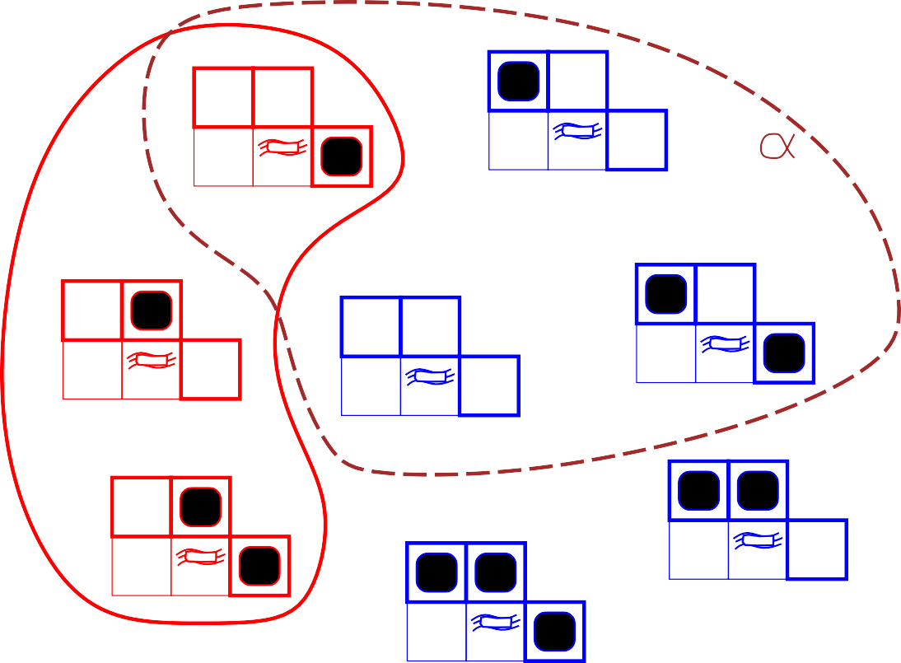
Wumpus models
2
2
PIT
1
Breeze
PIT
1
Breeze
2
KB
1
2
3
1
2
3
2
PIT
2
PIT
2
1
Breeze
PIT
1
Breeze
1
Breeze
1
2
3
1
2
3
1
2
3
2
PIT
2
PIT
PIT
1
Breeze
PIT
1
Breeze
2 PIT
PIT
1
2
3
1
2
3
1
Breeze
PIT
1
2
3
KB = wumpus-world rules + observations
α₂ = “[2,2] is safe”, KB |= α₂
© 2022 Pearson Education Ltd.

Slide 31
Inference
KB f--_{i} α = sentence α can be derived from KB by procedure i
Consequences of KB are a haystack; α is a needle. Entailment = needle in haystack; inference = finding it
Soundness: i is sound if
whenever KB f--_{i} α, it is also true that KB |= α
Completeness: i is complete if
whenever KB |= α, it is also true that KB f--_{i} α
Preview: we will define a logic (first-order logic) which is expressive enough to say almost anything of interest, and for which there exists a sound and complete inference procedure.
That is, the procedure will answer any question whose answer follows from what is known by the KB.
© 2022 Pearson Education Ltd.

Slide 32
Propositional logic: Syntax
Propositional logic is the simplest logic—illustrates basic ideas
The proposition symbols P₁, P₂ etc are sentences If S is a sentence, ¬S is a sentence (negation)
If S₁ and S₂ are sentences, S₁ ∧ S₂ is a sentence (conjunction) If S₁ and S₂ are sentences, S₁ ∨ S₂ is a sentence (disjunction)
If S₁ and S₂ are sentences, S₁ ⇒ S₂ is a sentence (implication)
If S₁ and S₂ are sentences, S₁ ⇔ S₂ is a sentence (biconditional)
© 2022 Pearson Education Ltd.

Slide 33
Propositional logic: Semantics
Each model specifies true/false for each proposition symbol
E.g.
P1,2 P2,2 P3,1
true true false
(With these symbols, 8 possible models, can be enumerated automatically.)
Rules for evaluating truth with respect to a model m:
¬S
is true iff is true iff is true iff is true iff is false iff is true iff
S is false
S₁ is true and
S₁ is true or
S₁ is false or
S₁ is true and
S₁ ⇒ S₂ is true and S₂
S₁ ∧ S₂
S₂ is true
S₂ is true
S₂ is true
S₂ is false
⇒ S₁ is true
S₁ ∨ S₂
S₁ ⇒ S₂
i.e.,
S₁ ⇔ S₂
Simple recursive process evaluates an arbitrary sentence, e.g.,
¬P_{1,2} ∧ (P_{2,2} ∨ P_{3,1}) = true ∧ (false ∨ true) = true ∧ true = true
© 2022 Pearson Education Ltd.

Slide 34
Truth tables for connectives
P | Q | ¬P | P ∧ Q | P ∨ Q | P ⇒Q | P ⇔Q
false | false | true | false | false | true | true
false | true | true | false | true | true | false
true | false | false | false | true | false | false
true | true | false | true | true | true | true
© 2022 Pearson Education Ltd.

Slide 35
Wumpus world sentences
Let P_{i,j} be true if there is a pit in [i, j].
Let B_{i,j} be true if there is a breeze in [i, j].
¬P1,1
¬B1,1
B2,1
“Pits cause breezes in adjacent squares”
© 2022 Pearson Education Ltd.

Slide 36
Wumpus world sentences
Let P_{i,j} be true if there is a pit in [i, j].
Let B_{i,j} be true if there is a breeze in [i, j].
¬P1,1
¬B1,1
B2,1
“Pits cause breezes in adjacent squares”
B1,1 B2,1
⇔
⇔
(P1,2 ∨ P2,1)
(P1,1 ∨ P2,2 ∨ P3,1)
“A square is breezy if and only if there is an adjacent pit”
© 2022 Pearson Education Ltd.

Slide 37
Truth tables for inference
B1,1 | B2,1 | P1,1 | P1,2 | P2,1 | P2,2 | P3,1 | R₁ | R₂ | R₃ | R₄ | R₅ | KB
false false . false | false false . true | false false . false | false false . false | false false . false | false false . false | false true . false | true true . true | true true . true | true false . false | true true . true | false false . true | false false . false
false false false | true true true | false false false | false false false | false false false | false true true | true false true | true true true | true true true | true true true | true true true | true true true | true true true
false . true | true . true | false . true | false . true | true . true | false . true | false . true | true . false | false . true | false . true | true . false | true . true | false . false
Enumerate rows (different assignments to symbols), if KB is true in row, check that α is too
© 2022 Pearson Education Ltd.

Slide 38
Inference by enumeration
Depth-first enumeration of all models is sound and complete
function TT-Entails?(KB, α) returns true or false
inputs: KB, the knowledge base, a sentence in propositional logic
α, the query, a sentence in propositional logic
symbols ← a list of the proposition symbols in KB and α
return TT-Check-All(KB, α, symbols, [ ])
function TT-Check-All(KB, α, symbols, model) returns true or false
if Empty?(symbols) then
if PL-True?(KB, model) then return PL-True?(α, model)
else return true
else do
P ← First(symbols); rest ← Rest(symbols)
return TT-Check-All(KB, α, rest, Extend(P , true, model )) and
TT-Check-All(KB, α, rest, Extend(P , false, model ))
O(2^{n}) for n symbols; problem is co-NP-complete
© 2022 Pearson Education Ltd.

Slide 39
Logical equivalence
Two sentences are logically equivalent iff true in same models:
α ≡ β if and only if α |= β and β |= α
(α ∧ β) ≡ (β ∧ α) commutativity of ∧
(α ∨ β) ≡ (β ∨ α) commutativity of ∨ ((α ∧ β) ∧ γ) ≡ (α ∧ (β ∧ γ)) associativity of ∧ ((α ∨ β) ∨ γ) ≡ (α ∨ (β ∨ γ)) associativity of ∨
¬(¬α) ≡ α double-negation elimination
(α ⇒ β) ≡ (¬β ⇒ ¬α) contraposition
(α ⇒ β) ≡ (¬α ∨ β) implication elimination
(α ⇔ β) ≡ ((α ⇒ β) ∧ (β ⇒ α)) biconditional elimination
¬(α ∧ β) ≡ (¬α ∨ ¬β) De Morgan
¬(α ∨ β) ≡ (¬α ∧ ¬β) De Morgan
(α ∧ (β ∨ γ)) ≡ ((α ∧ β) ∨ (α ∧ γ)) distributivity of ∧ over ∨
(α ∨ (β ∧ γ)) ≡ ((α ∨ β) ∧ (α ∨ γ)) distributivity of ∨ over ∧
© 2022 Pearson Education Ltd.

Slide 40
Validity and satisfiability
A sentence is valid if it is true in all models,
e.g., True, A ∨ ¬A, A ⇒ A, (A ∧ (A ⇒ B)) ⇒ B
Validity is connected to inference via the Deduction Theorem:
KB |= α if and only if (KB ⇒ α) is valid
A sentence is satisfiable if it is true in some model e.g., A ∨ B, C
A sentence is unsatisfiable if it is true in no models e.g., A ∧ ¬A
Satisfiability is connected to inference via the following:
KB |= α if and only if (KB ∧ ¬α) is unsatisfiable i.e., prove α by reductio ad absurdum
© 2022 Pearson Education Ltd.

Slide 41
Proof methods
Proof methods divide into (roughly) two kinds:
Application of inference rules
Legitimate (sound) generation of new sentences from old
Proof = a sequence of inference rule applications
Can use inference rules as operators in a standard search alg.
Typically require translation of sentences into a normal form
Model checking
truth table enumeration (always exponential in n)
improved backtracking, e.g., Davis–Putnam–Logemann–Loveland heuristic search in model space (sound but incomplete)
e.g., min-conflicts-like hill-climbing algorithms
© 2022 Pearson Education Ltd.

Slide 42
Resolution
Conjunctive Normal Form (CNF—universal)
conjunction of disjunctions of literals
..
cla uses
E.g., (A ∨ ¬B) ∧ (B ∨ ¬C ∨ ¬D)
Resolution inference rule (for CNF): complete for propositional logic
/J₁ ∨ · · · ∨ /J_{k}, m₁ ∨ · · · ∨ m_{n}
/J₁ ∨ · · · ∨ /J_{i−1} ∨ /J_{i+1} ∨ · · · ∨ /J_{k} ∨ m₁ ∨ · · · ∨ m_{j−1} ∨ m_{j+1} ∨ · · · ∨ m_{n}
where /J_{i} and m_{j} are complementary literals. E.g.,
P1,3 ∨ P2,2, ¬P2,2
P
P?
P1,3
B OK
A
P? OK
A
Resolution is sound and complete for propositional logic
OK S
A
OK
A
W

Slide 43
Conversion to CNF
B1,1 ⇔ (P1,2 ∨ P2,1)
1. Eliminate ⇔, replacing α ⇔ β with (α ⇒ β) ∧ (β ⇒ α).
(B1,1
⇒ (P_{1,2} ∨ P_{2,1})) ∧ ((P_{1,2} ∨ P_{2,1}) ⇒ B_{1,1})
Eliminate ⇒, replacing α ⇒ β with ¬α ∨ β.
(¬B_{1,1} ∨ P_{1,2} ∨ P_{2,1}) ∧ (¬(P_{1,2} ∨ P_{2,1}) ∨ B_{1,1})
Move ¬ inwards using de Morgan’s rules and double-negation:
(¬B_{1,1} ∨ P_{1,2} ∨ P_{2,1}) ∧ ((¬P_{1,2} ∧ ¬P_{2,1}) ∨ B_{1,1})
Apply distributivity law (∨ over ∧) and flatten:
(¬B_{1,1} ∨ P_{1,2} ∨ P_{2,1}) ∧ (¬P_{1,2} ∨ B_{1,1}) ∧ (¬P_{2,1} ∨ B_{1,1})

Slide 44
Resolution algorithm
Proof by contradiction, i.e., show KB ∧ ¬α unsatisfiable
function PL-Resolution(KB, α) returns true or false
inputs: KB, the knowledge base, a sentence in propositional logic
α, the query, a sentence in propositional logic
clauses ← the set of clauses in the CNF representation of KB ∧ ¬α
new ← { }
loop do
for each C_{i}, C_{j} in clauses do
resolvents ← PL-Resolve(C_{i}, C_{j} )
if resolvents contains the empty clause then return true new ← new ∪ resolvents
if new ⊆ clauses then return false clauses ← clauses ∪ new

Slide 45
Resolution example
KB = (B_{1,1} ⇔ (P_{1,2} ∨ P_{2,1})) ∧ ¬B_{1,1} α = ¬P_{1,2}
P2,1 B1,1
B1,1 P1,2 P2,1
P1,2
B1,1
B1,1
P1,2
B1,1
P1,2
B1,1
P1,2
P2,1
P1,2
B1,1
P2,1
B1,1 _{P1,2}
P2,1
P2,1
P2,1
P1,2

Slide 46
Forward and backward chaining
Horn Form (restricted)
KB = conjunction of Horn clauses
Horn clause =
proposition symbol; or
(conjunction of symbols) ⇒ symbol E.g., C ∧ (B ⇒ A) ∧ (C ∧ D ⇒ B)
Modus Ponens (for Horn Form): complete for Horn KBs
α₁, . . . , α_{n}, α₁ ∧ · · · ∧ α_{n} ⇒ β β
Can be used with forward chaining or backward chaining. These algorithms are very natural and run in linear time
© 2022 Pearson Education Ltd.

Slide 47
Forward chaining
Idea: fire any rule whose premises are satisfied in the KB, add its conclusion to the KB, until query is found
Q
P ⇒ Q
L ∧ M ⇒ P B ∧ L ⇒ M A ∧ P ⇒ L
P
M
A ∧ B ⇒ L
A B
L
A
B
© 2022 Pearson Education Ltd.

Slide 48
Forward chaining algorithm
function PL-FC-Entails?(KB, q) returns true or false
inputs: KB, the knowledge base, a set of propositional Horn clauses
q, the query, a proposition symbol
local variables: count, a table, indexed by clause, initially the number of premises inferred, a table, indexed by symbol, each entry initially false agenda, a list of symbols, initially the symbols known in KB
while agenda is not empty do p ← Pop(agenda) unless inferred[p] do
inferred[p] ← true
for each Horn clause c in whose premise p appears do
decrement count[c]
if count[c] = 0 then do
if Head[c] = q then return true
Push(Head[c], agenda)
return false
© 2022 Pearson Education Ltd.

Slide 49
Forward chaining example
Q
1
P
2
M
2
L
2
2
A
B
© 2022 Pearson Education Ltd.

Slide 50
Forward chaining example
Q
1
P
2
M
2
L
1
1
A
B
© 2022 Pearson Education Ltd.

Slide 51
Forward chaining example
Q
1
P
2
M
1
L
1
0
A
B
© 2022 Pearson Education Ltd.

Slide 52
Forward chaining example
Q
1
P
1
M
0
L
1
0
A
B
© 2022 Pearson Education Ltd.

Slide 53
Forward chaining example
Q
1
P
0
M
0
L
1
0
A
B

Slide 54
Forward chaining example
Q
0
P
0
M
0
L
0
0
A
B
© 2022 Pearson Education Ltd.

Slide 55
Forward chaining example
Q
0
P
0
M
0
L
0
0
A
B
© 2022 Pearson Education Ltd.

Slide 56
Forward chaining example
Q
0
P
0
M
0
L
0
0
A
B
© 2022 Pearson Education Ltd.

Slide 57
Proof of completeness
FC derives every atomic sentence that is entailed by KB
FC reaches a fixed point where no new atomic sentences are derived
Consider the final state as a model m, assigning true/false to symbols
Every clause in the original KB is true in m
Proof: Suppose a clause a₁ ∧ . . . ∧ a_{k} ⇒ b is false in m Then a₁ ∧ . . . ∧ a_{k} is true in m and b is false in m Therefore the algorithm has not reached a fixed point!
Hence m is a model of KB
If KB |= q, q is true in every model of KB, including m
General idea: construct any model of KB by sound inference, check α
© 2022 Pearson Education Ltd.

Slide 58
Backward chaining
Idea: work backwards from the query q: to prove q by BC,
check if q is known already, or
prove by BC all premises of some rule concluding q
Avoid loops: check if new subgoal is already on the goal stack Avoid repeated work: check if new subgoal
has already been proved true, or
has already failed
© 2022 Pearson Education Ltd.

Slide 59
Backward chaining example
Q
P
M
L
A
B
© 2022 Pearson Education Ltd.

Slide 60
Backward chaining example
Q
P
M
L
A
B
© 2022 Pearson Education Ltd.

Slide 61
Backward chaining example
Q
P
M
L
A
B
© 2022 Pearson Education Ltd.

Slide 62
Backward chaining example
Q
P
M
L
A
B
© 2022 Pearson Education Ltd.

Slide 63
Backward chaining example
Q
P
M
L
A
B
© 2022 Pearson Education Ltd.

Slide 64
Backward chaining example
Q
P
M
L
A
B
© 2022 Pearson Education Ltd.

Slide 65
Backward chaining example
Q
P
M
L
A
B
© 2022 Pearson Education Ltd.

Slide 66
Backward chaining example
Q
P
M
L
A
B
© 2022 Pearson Education Ltd.

Slide 67
Backward chaining example
Q
P
M
L
A
B
© 2022 Pearson Education Ltd.

Slide 68
Backward chaining example
Q
P
M
L
A
B
© 2022 Pearson Education Ltd.

Slide 69
Backward chaining example
Q
P
M
L
A
B
© 2022 Pearson Education Ltd.

Slide 70
Forward vs. backward chaining
FC is data-driven, cf. automatic, unconscious processing, e.g., object recognition, routine decisions
May do lots of work that is irrelevant to the goal BC is goal-driven, appropriate for problem-solving,
e.g., Where are my keys? How do I get into a PhD program?
Complexity of BC can be much less than linear in size of KB
© 2022 Pearson Education Ltd.

Slide 71
Effective Propositional Model Checking
Davis–Putnam algorithm with three improvements over TT-ENTAILS
Early termination: detect T/F
Pure symbol heuristic: same sign in all clauses
Unit Clause heuristic: clause with one literal
Local search algorithms such as hill-climbing & simulated annealing.
In recent years, there has been a great deal of experimentation to find a
good balance between greediness and randomness.
WALKSAT: On every iteration, the algorithm picks an unsatisfied clause and
picks a symbol in the clause to flip.
© 2022 Pearson Education Ltd.

Slide 72
Summary
Logical agents apply inference to a knowledge base to derive new information and make decisions
Basic concepts of logic:
syntax: formal structure of sentences
semantics: truth of sentences wrt models
entailment: necessary truth of one sentence given another
inference: deriving sentences from other sentences
soundess: derivations produce only entailed sentences
completeness: derivations can produce all entailed sentences
Wumpus world requires the ability to represent partial and negated informa- tion, reason by cases, etc.
Forward, backward chaining are linear-time, complete for Horn clauses Resolution is complete for propositional logic. Propositional logic lacks expressive power
Local search methods (WALKSAT) find solutions (sound but not complete).
© 2022 Pearson Education Ltd.

